Slide 1
BOMBINO FBB PRESENTATION

Slide 2
ABOUT US
Bombino Express Worldwide Inc handle inventory, order processing, and shipping functions for other businesses. Handing these daily tasks over to a fulfillment partner lets them focus on marketing, product development, and other growth drivers.

Slide 3
HOW FBB WORKS
Once you're on board, we'll collect your inventory & store in your warehouse
We will tally the stocks and put the inventory live
You can start taking orders from respective market place

Slide 4
BENEFITS OF FBB
Effortless Logistics and Shipping Services
Unlimited Storage Space
Cost Effective
Reducing Delivery Timeline
Showing presence in US Marketing
3 months Warehousing FREE
No LTSF (Long Term Storage Fee)
Management of Return Shipping
Fulfillment of Orders from Any E-Commerce Platforms in USA and Rest Of the World.
24/7 customer support via phone and emails.

Slide 5
WAREHOUSE LOCATIONS
USA
13 Division Street, Unit B, Fairview, New Jersey - 07022.
646 224 0700 ext. 325
fbb@bombinoexp.com
INDIA
Corporate Centre B, 1 & 2, Ground Floor, Marol Pipeline, Andheri Kurla Road, Mumbai - 400 059.
+91 22 6640 0197
Toll Free: 1800 266 6401 ext. 197
+91 7710 037 353 / 9867 586 480
fbb@bombinoexp.com

Slide 6
SERVICES
Under 1LB (450 Grams)
USPS FIRST CLASS PACKAGE [Postal]
Over 1LB (450 Grams)
FEDEX GROUND [Only Commercial Address]
FEDEX STANDARD OVERNIGHT.
FEDEX SMARTPOST [Postal]
FEDEX HOME DELIVERY [Only Residential Address]

Slide 7
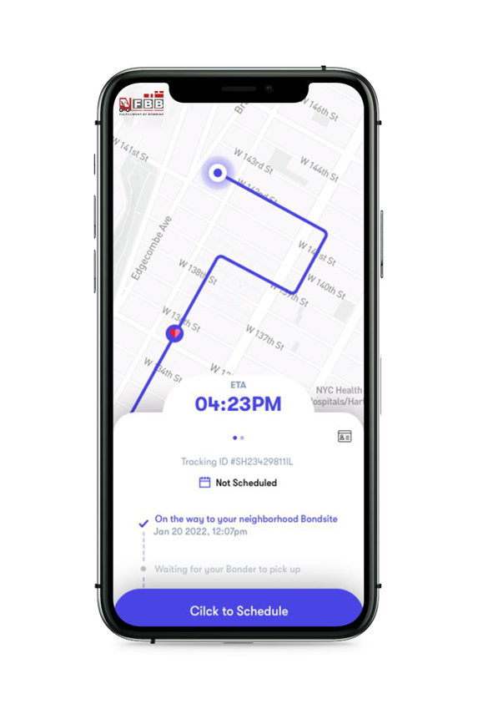
DELIVERY TIMELINES
First Mile
Transit time for inventory to reach our USA warehouse and getting in scanned is 4-5 working days after inventory is dispatched from Bombino Mumbai Warehouse.
Last Mile
Last mile delivery timelines are as follows : -
USPS First Class
Delivery within 3 - 7 working days (All over USA)
b. FedEx Smart Post
USA 1 - Delivery within 5 - 6 working days
USA 2 - Delivery within 7 - 8 working days

Slide 8
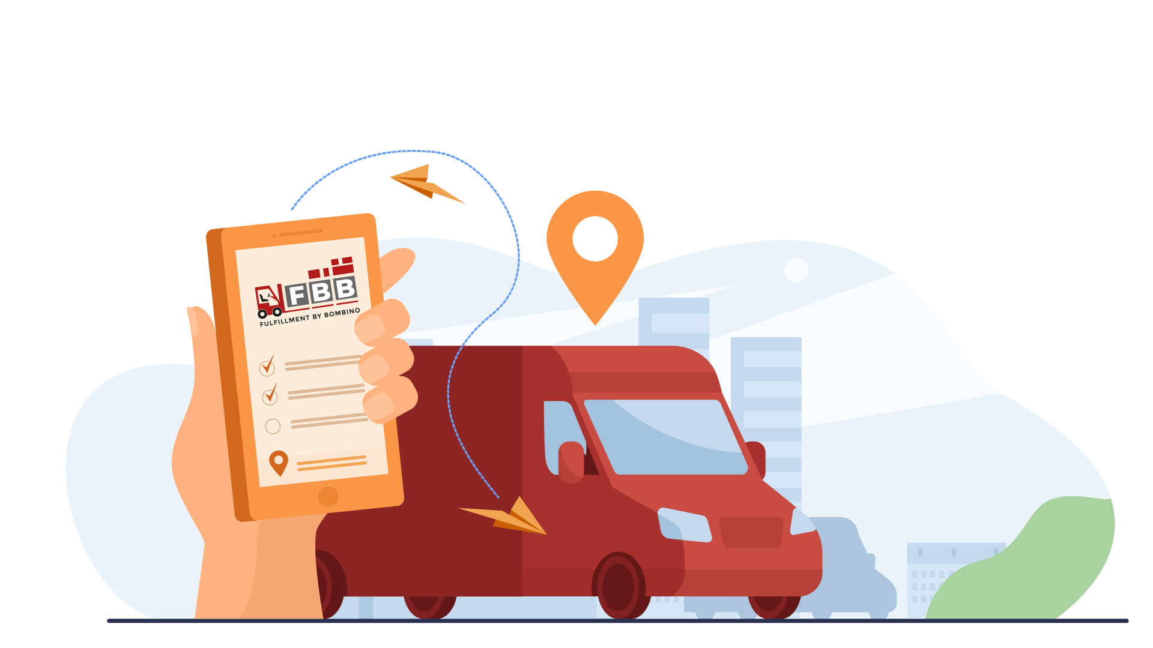
DELIVERY TIMELINES
c. FedEx Ground
USA 1 - Delivery within 3 working days
USA 2 - Delivery within 5 - 6 working days
d. FedEx Home Delivery
USA 1 - Delivery within 3 working days
USA 2 - Delivery within 5 - 6 working days
e. FedEx Standard Overnight
Next Working Day delivery all over USA.

Slide 9
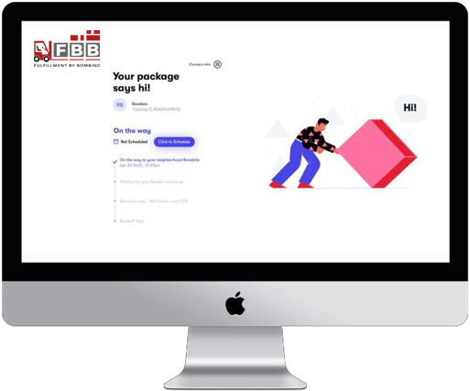
Track your order status from the moment you place it until it arrives

Slide 10
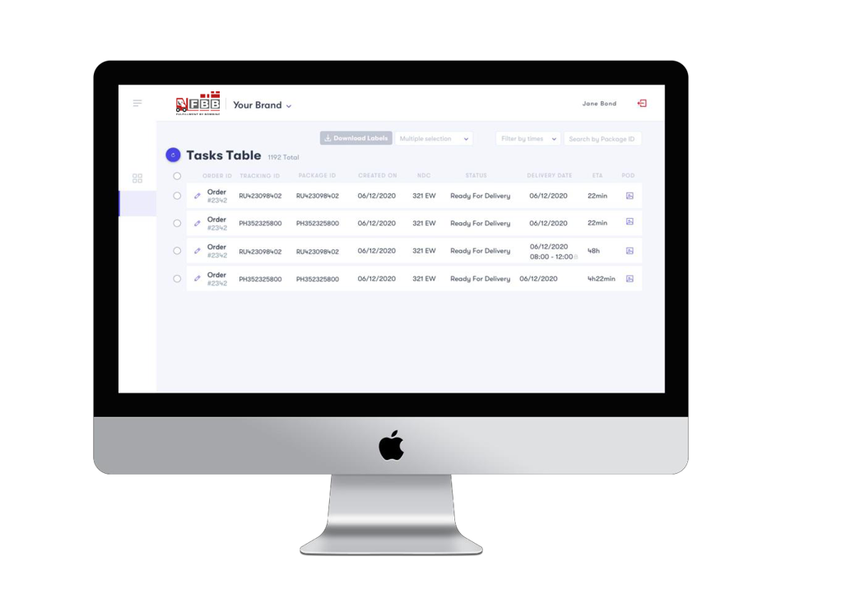
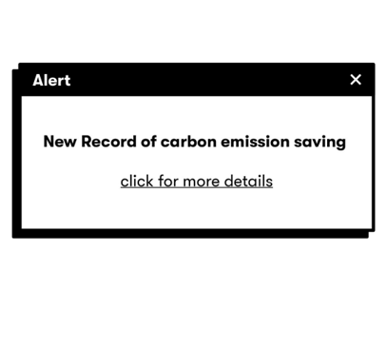
Admin Dashboard to enable visibility and order management

Slide 11
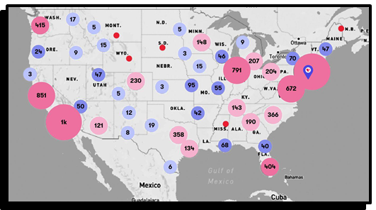
Better Ops Planning-predictive and more efficient infrastructure based on *your* real data

Slide 12
SUMMARY
Faster
Enable Prediction
and Growth
Full Visibility
Same-day / Next-day
scheduled deliveries, returns and exchanges.
Full transparency and visibility throughout the entire process. Reduces friction between consumer-brand & brand-carrier.
As a data-driven company, FBB enables brands to base their growth, marketing & ops resources on real data and to make better decisions.
Efficient Ops
Management
Saves time, labor
costs and frustration
Inventory management, restocking, usage reports and returns bundling.
The easiest, most cost-eﬀective last-mile solution on the market. Finally you can focus on other areas of your business, we’ve got the last mile covered.

Slide 13
THANK YOU

